Slide 1
English-Speaking Union 2018 Annual General Meeting
A Year in Review:
Development
Rossana Ivanova
Director of Development
November 18, 2018
New Orleans, LA
Notes:
My name is Rossana Ivanova. I’m ESU’s development director in charge of raising funds for our educational programs.
I joined the ESU last October and had the opportunity to meet some of you at last year’s annual general meeting in Louisville KY.
And some of you I’m meeting for the first time and I’m thrilled to have the opportunity to tell you a bit about what I do at the ESU.
ESU’s mission speaks to me personally. I love the English language. I have experienced first hand its power to open up opportunities and offer choices.
So I’m proud to be part of this distinguished organization, and to work to employ the English language toward understanding and good will, opportunity and empowerment.

Slide 2
Esu Fundraising for programs and operations
Andrew Romay New Immigrant Center
ESU Middle School Debate
General Support
ESU National Shakespeare Competition
Secondary School Exchange
Luard Morse Scholarships
Notes:
This past year was very exciting. I was learning about our programs as I was actively pursuing donors for our educational programs and for general operating support:
It’s amazing the number of teachers, students and newcomers to America who have benefitted last year benefit from our, from your educational programs.

Slide 3
Esu fundraising sources
Individuals
Foundations
Companies
ESU PROGRAMS
Notes:
We raise philanthropic dollars from individuals – such as you. Many of you make gifts in support of our programs. Our programs wouldn’t have been possible without your support.
So on behalf of all staff and beneficiaries of the ESU, thank you!
Foundation and corporation grants and gifts are also an important source of funding.

Slide 4
Annual board giving total goal vs raised
100% 2017-2018
Notes:
Donations from our board of directors are an important source of general operating support.
Each board member is asked to contribute a minimum of $1,000 and the majority of our board members make bigger gifts – thank you, Paul, Quinn, Donald, Laura…
The campaign was launched four years ago under the leadership of ESU President Quinn Peeper and as you can see each year it has exceeded its goal.
And in 2018 we had 100% participation.
This success speaks to our board’s commitment to the organization and is something that foundations ask about when considering grants.

Slide 5
Esu year-end campaign - $55,000
9,000
7,700
800
15,000
Notes:
Fundraising from individuals other than the board is another major undertaking.
The ESU year-end campaign consists of a number of appeals that solicit donations for specific programs as well as general operating support.
The annual report is already on its way to nearly 9000 of you. I’m really proud of it because it tells the story of the ESU’s impact on so many members, students, teachers, volunteers, English learners.
It is a way to keep you in informed. It also includes a return donation envelope for those who are inspired by our work to support it.
Nearly 8,000 appeal letters are going to members and friends of our programs,
With these letters we appeal to our members, volunteers, alumni to support the programs that resonate with them the most. We get the help of a mail house for these appeals.
Another 800 very personalized letters will be sent to our most loyal supporters. Personally signed, these letters talk to our loyal donors directly.
We pay attention to what is important to you, what you’ve supported in the past. And invite you to continue to be part of it.
Of course, you can always direct your dollars to something else, but we want to make sure that we pay attention to your preferences.

Slide 6
esu supporters – new and cultivating
6
4
8
3
4
Corporations
Foundations
Major Donors $1,000+
Foundations
Corporations
14
Major Donors $1,000+
Recruited
Cultivating
Notes:
A major role of mine is expanding the roster of our supporters.
I spend a lot of time researching and identifying prospective donors.
Then I persistently cultivate their interest and commitment with regular communications. Over the past year, we signed up several new donors.
I’m pursuing a number of prospects. It’s a long-term process of building relationships and trust
Because asking for the donation is the easiest part. What matters most is what comes before the ask – the cultivation – and what comes after the ask – the appreciation.
This is where the excellence of our programs comes into play.
I use the events we organize
to introduce the ESU to new friends,
raise its visibility and influence.

Slide 7
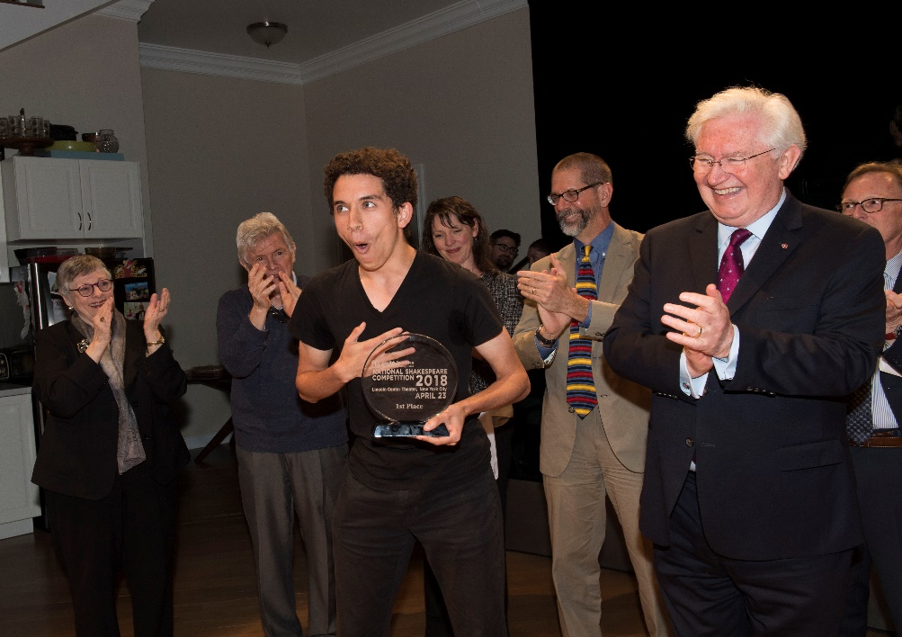
ESU PROGRAM ACTIVITIES – CULTIVATION TOOL
Impress
Attract
Ask
Recognize
3 new major donors
1 new corporation
Notes:
The ESU National Shakespeare Competition in April is an especially appropriate opportunity to showcase the English-Speaking Union. Thank you, Paul, for founding this one-of-a-kind endeavor. Thank you also for supporting it so generously – this past year Paul Beresford-Hill donated the grand prize award – scholarship too the Young Artists Summer School at the Royal Academy of Dramatic Art in London.
This is a program you, members, support wholeheartedly – 55 branches participate.
You organize local rounds and send a semi-finalist to New York for the finals.
These are extraordinary young people. Not only are very gifted, but they show strong character, discipline, self-confidence as well as camaraderie – you should see how they support each other.
Students develop an appreciation for the beauty of Shakespeare’s language and the power of words.
Equally importantly, Shakespeare’s timeless themes of
love and hate,
valor and cowardice,
trust and betrayal,
Joy and grief
teach students the enduring values of:
Integrity
Compassion
Loyalty
Responsibility

Slide 8
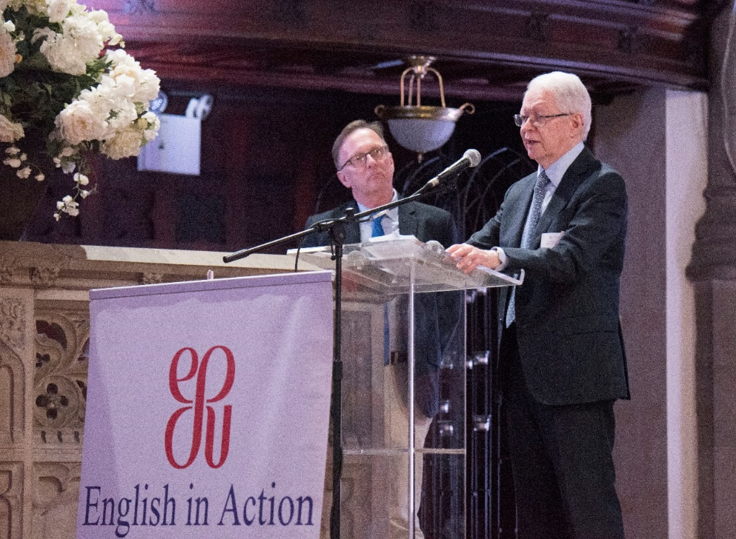
Esu Andrew romay new immigrant center class of 2018 graduation
2 major grants renewed
2 new major grants pending
4 new foundations recruited
4 new corporate supporters
Notes:
English in Action Conversations and the ESU Andrew Romay New Immigrant Center give new immigrants the gift of English fluency as well as the skills resources information and confidence to become fully contributing members of American economy and society.
The program is made possible by the generous grants from the Andrew and Marietta Romay Foundation. I want to thank our board member Peter Frey, trustee of the foundation, for his support and vote of confidence.
Our students are highly skilled nearly all of them have higher education in their home countries. What our program does is combat brain waste. It gives them that final edge to achieve professional fulfillment.
The spring Graduation for the outgoing class of students is an opportunity to highlight the program and secure new supporters. For a few years now we’ve also held a fundraising event, a dinner, after the formal graduation ceremony.
This year the ceremony was held at the Fourth Universalist Society of New York, a beautiful church on Central Park West, and an embodiment of the best America has to offer.
Its design was modelled after the Magdalen Tower at Oxford.
A truly inspiring place
The event featured a number of government officials, presentations by graduates and a keynote address by a prominent immigrant, Dr. Jan Vilcek, a refugee from then Czechoslovakia and the inventor of the blockbuster drug Remicade.

Slide 9
ESU MIDDLE SCHOOL DEBATE
3 grants renewed
1 new major grant pending
Notes:
I’ve discovered that funders are really moved when they see our programs in action.
I make special efforts to bring foundation program officers debate tournaments.
Witnessing firsthand these adolescents debate is an extraordinary experience.
I hounded a foundation officer for a month before he finally agreed to spend a Saturday morning watching the Championship Tournament
You should have seen him watch in amazement these kids debate the question of whether reptiles should or should not be kept as pets.
I knew our grant was assured.

Slide 10
ESU MIDDLE SCHOOL DEBATE

Slide 11
TLAB FOR LIFELONG LEARNERS SUPPORTS TLAB
Travel and Learn Abroad (TLab for Lifelong Learners)
Teachers Learning Abroad (TLab)
Notes:
I want to mention another program that is wonderful for attracting new members and supporters.
Travel and Learn Abroad – Tlab for Lifelong Learners – is an offshoot of our venerable Teachers Learning Abroad program supported by so many of you. You donate to your branches to send teachers from your community to study in the UK.
Well, Travel and Learn Abroad – Tlab for Lifelong Learners is designed for all of you who
appreciate the English language and
want to experience more profoundly the cultural riches of the UK.
These trips offer unique opportunities for enrichment and excitement –
lectures by renowned scholars,
behind the scenes tours,
exclusive access to archives, and the
company of like-minded intellectually curious and adventurous fellow travelers.
Some of you may already have participated in one of our Tlab for Lifelong learners trips. If you haven’t, you must go – the experience is exceptional, the memories are for ever.
A number of participants have signed up to be members of the ESU and are making donations to our programs because they were so captivated by the experience.
And most importantly, by having fun you’ll also be doing good because proceeds from your trip will go toward scholarships for teachers to continue their professional development in Tlab.

Slide 12
ESU CENTENNIAL 2020
Celebrate our illustrious past
Embrace a vision for the next 100 years
Find fame, friends and funds
Notes:
This past year we started preparations for the ESU Centennial.
As you probably know the ESU of US was founded in 1920, just two years after the ESU of the Commonwealth, our sister organization.
It is a once-in-a-lifetime event. The next opportunity will not be until 2120.
We have an example to follow. The ESU of the Commonwealth celebrated its centenary this past May. Jane Easton the Executive Director of the ESU of the Commonwealth Dartmouth House is here with us. She led the celebrations on the other side of the pond. I wasn’t part of the US delegation but I understand that the festivities were extraordinary and befitting the historic occasion.
So the bar is set very high and we are under pressure to meet and even exceed it. We should make our founder, sir Evelyn Wrench, proud.

Slide 13
THE NEXT 100: TRANSFORMING LIVES THROUGH THE POWER OF the English LANGUAGE
Newcomers to US
Students
Teachers
Members
BRANCHES PROGRAMS
Notes:
I’ve been working with Renee LiaBraaten, our consultant, on formulating a vision for the organization. She has spoken with a number of our members. The vision for the ESU’s next 100 years is grounded in recognizing the contributions of our members and branches.
The theme is “the Next 100..”
Because you support and make possible the programs that transform the lives of members, yourselves, teachers, students and newcomers to the U.S. through the power of the English language.
It is the language of opportunity, the language that empowers, and gives people choices.

Slide 14
THE NEXT 100: TRANSFORMING LIVES THROUGH THE POWER OF THE ENGLISH LANGUGE
Fundraising
Communications
Branch Events
National
Events
Branding
International
Notes:
Our Centennial will have a strong fundraising component. Renee LiaBraaten helped us to evaluate our needs and standing and formulate a plan and a cause.
What came out of her extensive conversations with many of you is that endowing the Evelyn Wrench speaker series to ensure it continues in perpetuity is a goal many of you would support.
We also are exploring the idea of fundraising for regional coordinators – staff members who would work with the branches to run the programs you embrace and are appropriate for your community – the Shakespeare Competition, English in Action conversations, Tlab, as well as branch meetings and events.
Job description needs to be specific to strengthening the branches.
The Centennial will also shape
communications and
Branding
It will feature exciting events at the branch level, national and international.

Slide 15
Happy Birthday, ESU! A year of celebration Fall 2019
Annual General Meeting Conference
“Farewell to the First Century”
Benefit Gala “In Honor of”
Location to be determined
Proposals to host welcome
Notes:
What I propose is not a day or a week but a year of celebrations to mark the ESU Centennial.
We will organize all our regular programs under the banner of the anniversary and add special events.
We will start with next fall’s annual general meeting.
The theme could be “Farewell to the First Century”. It may include a special dinner – a gala in someone’s honor. Someone who has contributed to the eminence of our organization.
The ESU certainly knows how to through parties. Just think about last night gala!

Slide 16
ESU GALA, New Orleans, 2018 A NIGHT AT THE SYMPHONY HALL

Slide 17
Happy Birthday, ESU! A year of celebrations April 2020
ESU National Shakespeare Competition Finals “The Power of Shakespeare’s Language to Change Lives”
Celebration Dinner
Notes:
Throughout the year, our regular events will pay tribute to the big anniversary.
The Shakespeare competition could celebrate the power of Shakespeare’s language to change lives, for example.

Slide 18
Happy Birthday, ESU! A year of celebrations may 2020
Andrew Romay New Immigrant Center
Graduation Ceremony and Dinner
“Welcome to America:
The Next 100 Years”
Notes:
Our Andrew Romay New Immigrant Center Graduation Ceremony and Dinner could be another tribute to the ESU’s impact on people’s lives.
under the heading “Welcome to America – the next 100 years!”

Slide 19
Happy Birthday, ESU! A year of celebrations SPRING & EARLY SUMMER 2020
Celebration events
in Branches
across the US
Notes:
Throughout the spring and summer our branches will be celebrating and acknowledging this special year
the centennial with special events and activities with support from HQ staff.

Slide 20
ESU GALA, New Orleans, 2018 A NIGHT AT THE SYMPHONY HALL

Slide 21
Happy Birthday, ESU! The English-Speaking Union Centennial Celebration November 11-15, 2020
ESU US
members
volunteers
INTERNATIONAL
ESU-UK
OTHERS
elected officials
donors
beneficiaries
international ESUs
diplomatic corps
partners
media
celebrities
royalty
Notes:
The year of celebrations will culminate in the annual general meeting and International Council forum November 11-15 in New York City.
The dates have been set.
The guest list will be extensive.
For such an important occasion we must be inclusive.
And we hope that our friends at the ESU of the Commonwealth Dartmouth House will help us extend invitations to members of the Royal family to join the festivities.
Especially now that we have an American in the royal family.

Slide 22
Happy Birthday, ESU! The English-Speaking Union Centennial Celebration November 11-15, 2020, nyc
11
12
13
14
15
Arrival and gathering
IC Meeting
Gala Dinner
IC Meeting
Shakespeare Day
Welcome to America
ARNIC Day
Experience New York and Farewell until 2120!
Notes:
This is just a preliminary concept for this week in November.
Locations include:
United Nations Economic and Social Council chamber for the International Council meeting
The UN Delegates dining room for the gala
Morgan’s library for the Shakespeare competition demonstration
Visit and lunch to Ellis Island and a reception at the Tenement museum for Saturday, the 14 (Welcome to America day) and leisure activities on the Sunday, November 15 that may include bourbon or wine tasting on Long Island or a boat tour around Manhattan, or a special behind the scenes art gallery tour.

Slide 23
ESU Centennial November 12-13, 2020 International Council Meetings and Gala
EcoSoc Council Chamber
UN Delegates Dining Room
Notes:
Imagine, what if the International Council meeting would be held at the EcoSoc Council Chamber of the United Nations? Would there be a more fitting location for this event.
And what if the gala dinner was held in the UN Delegates Dining Room with sweeping views over East River?

Slide 24
ESU CENTENNIAL NOVEMBER 13, 2020 SHAKESPEARE DAY
Morgan Library and Museum
Broadway night
Notes:
Our Shakespeare day – when we will enjoy performances from our Shakespeare competitors – could be held in the magnificent Morgan Library and Museum with a private tour of Shakespeare’s First Folio.
The day could end with a fabulous night on Broadway.

Slide 25
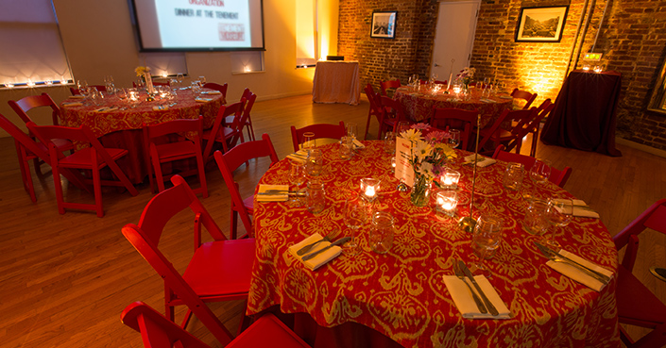
ESU CENTENNIAL NOVEMBER 14, 2020 WELCOME TO AMERICA DAY
Ellis Island and Statue of Liberty
Tenement Museum
Notes:
The next day, November 14, Saturday, will be the Welcome too America Day with a visit of Ellis Island and behind the scenes tour of its archives and lunch on the Island.
The day will end on a high note with a reception at the inspiring Tenement museum

Slide 26
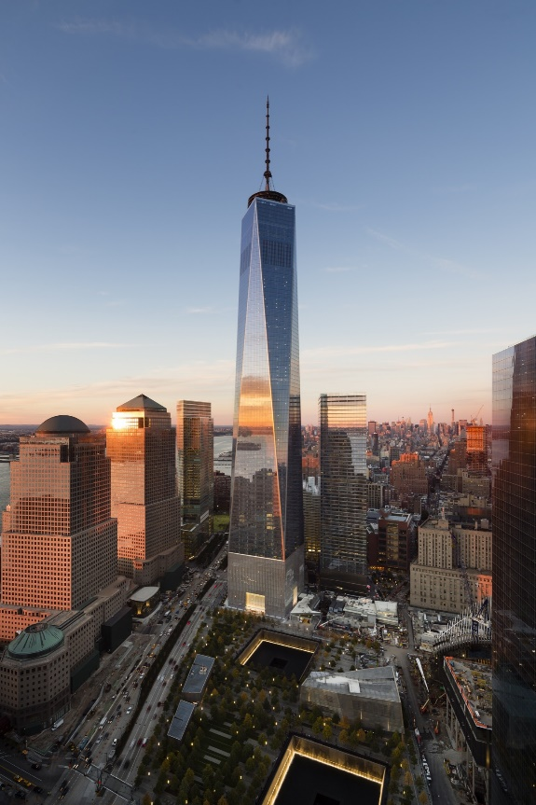
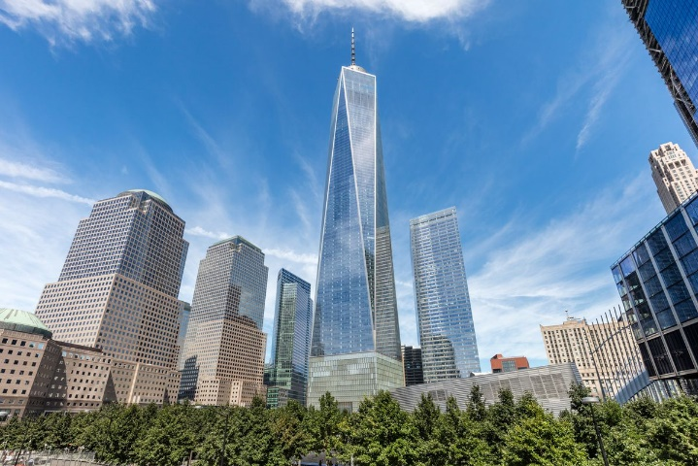
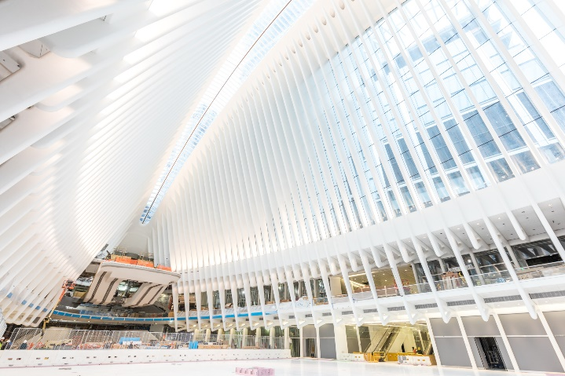
ESU CENTENNIAL NOVEMBER 15, 2020 FAREWELL UNTIL NEXT TIME IN 2120
Experience New York
Notes:
And finally on the farewell day we can experience New York in all its magnificence.
And promise to get together for the next centennial in 2120!
How do you want to celebrate the ESU Centennial?
Who should we invite?
Where should we gather?
How should we celebrate?
We want to plan this important year together. So please give me your ideas

Slide 27
ESU CENTENNIAL CELEBRATIONs across the us
Rossana Ivanova
212-818 1200 220
rivanova@esuus.org
Notes:
I welcome your ideas, comments and questions.
I’ve left pencils and paper on each chair for you to jot down your thoughts and pass them to me.
Or you can give me a call or drop me an email.

Slide 28
ESU CENTENNIAL CELEBRATIONs

Slide 29
ESU CENTENNIAL vISION
The Next 100: Transforming Lives through the
Power of the English Language
SUPPORT THE BRANCHES
STRENGTHEN THE PROGRAMS

Slide 30
Esu Centennial aspirations
Teachers
TLab Branch Scholarships
Scholarships from TLab for Lifelong Learners
High School Students
ESU National Shakespeare Competition in all 65 branches
Expansion to 30 new locations
Middle School Students
Work with branches to launch ESU Middle School Debate in 20 communities
English Learners
English in Action Conversations in six metro areas
Expand to ten metro areas
ESU Constituents
Members, volunteers, beneficiaries, friends
Evelyn Wrench Speaker Program

Slide 31
How will we achieve these goals?
Regional Coordinators
Evelyn Wrench Series Endowment

Slide 32
What does a capital campaign do?
Raises money
Rejuvenates people, renews vision
Increases volunteerism
Improves fundraising skills and confidence
Raises visibility and boosts public image

Slide 33
Types of Campaigns
Brick-and-mortar (building projects)
Special projects (equipment, one-time start-up funds)
Endowment
Combined (building, project, endowment)
Comprehensive (building, project, endowment, program)
Notes:
Brick and mortar – clear, easy to articulate and has immediate results, compelling results, PR opportunities
Special projects (equipment, start up funds, etc.) – clear, easy to articulate, immediate results
Endowment – long-term results, small return on investment
Combined (building, equipment, endowment) – complex, both short and long-term results, PR opportunities
Comprehensive (building, equipment, endowment, program) – complex, harder to articulate, short and long-term results, larger goals
Special Project Campaigns:
Well-defined project
Does not impose demands of a larger campaign

Slide 34
Special Characteristics
Grows out of a strategic plan
Goals are bigger
Moves the organization to a higher level
Provides new opportunities for involving donors
Comes to an end
Notes:
Emerge out of extensive organizational planning, when we pause to review the mission and vision, evaluate strengths and weaknesses, assess the programs and resources and identify areas to grow and the resources needed.
Campaign goals are bigger – usually multiples of annual fund size.

Slide 35
Phases of a Capital Campaign
Pre-planning
Planning
Lead Gifts
Insider Gifts
Kick-off
General Gifts
Follow through
Quiet Phase
Public Phase
Notes:
Pre-campaign preparation:
Build a strong board
Strengthen the development function
Increase the organization’s visibility and reputation
Conduct strategic planning to clarify mission
Campaign planning:
Agree on a vision (project, cause)
Conduct a feasibility study
Assembly the campaign committee to work on the campaign plan:
Case for support
Working goal
Campaign timetable
Campaign policies
Campaign leadership
Table of gifts showing the number of gifts of different amounts needed to reach the goal
Communication plan
Lead-Gift Solicitation
Identify prospects for lead-gifts
Develop strategy for each gift
Prepare proposals
Train volunteers
Solicit gifts
Advance Gift Phase – those closest to the organization: board members, campaign leaders, active volunteers
Between the lead and advance gifts the campaign should have raised between 50 and 70% of the goal.

Slide 36
The Campaign Objective
Why is the project needed?
Why now?
How will it work?
How much will it cost?

Slide 37
What Does a Feasibility Study Do?
Tests the campaign objective
Determines the organization’s readiness
Assesses potential and recommends a dollar goal
Presents a preliminary campaign timetable
Identifies potential campaign leaders and donors
Provides other insights on the organization’s standing
Notes:
The study is an essential safeguard prior to committing the organization to the risks and rigors of a campaign.
Helps to draft the case statement (investment prospectus) and tests it with potential donors. Does it make sense? Does it excite and inspire? Is it important to the community?
Determines the organization’s readiness for a campaign, i.e. whether and when to proceed with a campaign. Recommends areas to strengthen before going into a campaign.
Answers the question of how much money the organization can raise for the plan presented.

Slide 38
What Is a Gift Range Chart?
Gift Amount | # of Gifts | # of Prospects | Raised at This Level | Cumulative Total
$150,000 | 1 | 4 | $150,000 | $150,000
$75,000 | 2 | 8 | $150,000 | $300,000
$40,000 | 4 | 16 | $160,000 | $460,000
$20,000 | 8 | 32 | $160,000 | $620,000
$10,000 | 16 | 64 | $160,000 | $780,000
$5,000 | 24 | 96 | $120,000 | $900,000
$2,500 | 40 | 160 | $100,000 | $1,000,000

Slide 39
ESU’s Current Gift Chart (2017)
Gift Amount | # of Gifts | Raised at This Level | Cumulative Total
$200,000 | 2 | $400,000 | $400,000
$25,000 | 1 | $25,000 | $425,000
$10,000 | 5 | $50,000 | $475,000
$5,000 | 13 | $65,000 | $540,000
$2,500 | 15 | $37,500 | $577,500
$1,000 | 40 | $40,000 | $617,500
$750 | 6 | $4,500 | $622,000
$500 | 64 | $32,000 | $654,000
$300 | 257 | $77,100 | $731,100
$100 | 111 | $11,100 | $742,200
$50 | 149 | $7,450 | $749,650

Slide 40
Requirements for a Successful Campaign
Compelling need and a credible plan
Strong case for support
A realistic yet challenging goal
Previous fundraising success
Sufficient number of qualified prospects at each giving level
Strong staff support and resources
Full and early commitment by the board
Notes:
Compelling, pressing need and a credible plan to address it. The ESU needs a strategic investment to enable it to carry out its mission more fully.
A well articulated, strong case for support – the investment prospectus
A realistic yet challenging goal
Previous fundraising success
Strong staff support and resources
Full and early commitment by the board
Effective volunteer leadership
Realistic timetable
Identification and early solicitation of major gifts prospects –
A sufficient number of prequalified prospects for each giving level
the success of the campaign is determined by the top ten gifts.
It’s a variation of the 80/20 rule – that 80% of effects come from 20% of the causes.
Qualified prospect – has the means and interest in or connection to the organization’s mission
Why me?
What’s the need and how big is it?
Do I care? How much?
What can I do to help? Am I really needed?
What would it look like to get more involved?
How will I feel if I do?
What type of attention will I get?
What are other people like me doing?
What would it say about me to get more involved?
Do I trust this organization and this person?
Rule of thumb – one gift out of four qualified prospects.

Slide 41
Campaign Goal Evaluation
Ten times more than the annual fund?
Four prospects for each top-ten gift we need?
A donor able to give 15% of the campaign goal?
Successful peer organizations?
Notes:
Identification and early solicitation of major gifts prospects – the success of the campaign is determined by the top ten gifts

Slide 42
Esu operating income by source
unaudited FY 2017-2018
$2,538,598

Slide 43
Esu operating income by source
unaudited FY 2017-2018
$2,538,598

Slide 44
ESU NATIONAL SHAKESPEARE COMPETITION
CULTIVATION AND FRIEND-RAISING
RECOGNITION
Notes:
Well, I use the final rounds to invite VIPs and prospective donors to see firsthand the impact this program has on these young people. Their poise, eloquence, expressivity and intensity are extraordinary.
This is also an opportunity to recognize our existing supporters and thank them for their commitment.

Slide 45
esu continuing supporters
Grants
5
Major gifts
7
Notes:
A major role of mine is expanding the roster of our supporters. I spend a lot of time researching and identifying prospective donors and then persistently cultivating their interest and commitment. Over the past year, we signed up as regular donors six new corporations, four new foundations and 8 major donors.
I’m pursuing a number of other prospective donors.
This is where the excellence of our programs comes into play. I take advantage of all the events we organize to introduce the ESU to new friends, raise its visibility and influence.

